Slide 1
Deep Dream
Name | Roll No | PRN | DIV
Chitra Joshi | 324081 | U1310587 | D
Vedant Vedpathak | 322064 | 22110246 | B

Slide 2
Introduction
DeepDream is an algorithm that visualizes the patterns learned by a neural network.
Similar to when a child watches clouds and tries to interpret random shapes, DeepDream over-interprets and enhances the patterns it sees in an image.
It does so by forwarding an image through the network, then calculating the gradient of the image with respect to the activations of a particular layer.
The image is then modified to increase these activations, enhancing the patterns seen by the network, and resulting in a dream-like image.
This process was dubbed "Inceptionism".

Slide 3
Difference between CNN and DeepDream
CNNs are a class of deep neural networks that are primarily used for analyzing visual imagery. They have been highly successful in tasks such as image and video recognition, image classification, medical image analysis, natural language processing, and others.
Deep Dream is an algorithm developed by Google that uses a pre-trained CNN to enhance and modify images in a dream-like, surreal manner. It amplifies patterns in the image to create new, visually interesting images. The technique was originally devised to help understand what a CNN is seeing when it looks at an image, but it quickly became popular as an artistic tool.

Slide 4
Difference between CNN and DeepDream
The architecture of a CNN typically involves a series of convolutional layers, pooling layers, and fully connected layers. The convolutional layers apply various filters to the input to create feature maps, capturing important features like edges, textures, or more complex patterns in deeper layers. Pooling layers reduce the dimensionality of these feature maps, and fully connected layers perform classification or regression tasks based on the features extracted.
While Deep Dream utilizes the architecture of CNNs, it does so in a unique way. Instead of using the CNN to classify images, Deep Dream adjusts the input image to increase the activation of certain layers or neurons within the network. This often results in the amplification of specific patterns or features that the network recognizes, such as eyes or architectural structures.

Slide 5
How does DeepDream work?
First, we provide an image to the convolutional neural networks and the first layer of the network distinguishes the low-level features such as edges.
In the next step, the second layer of the network will try to expose the higher-level features of the picture such as trees, cars, faces, etc.
Lastly, the remaining layers will try to collect all of these features and complete the interpretations so that the pictures can be categorized accordingly.

Slide 6
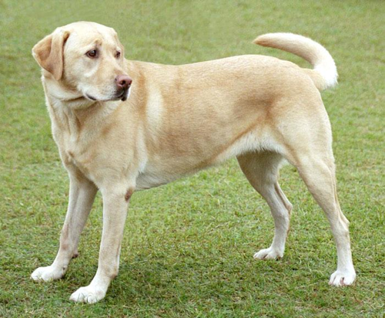
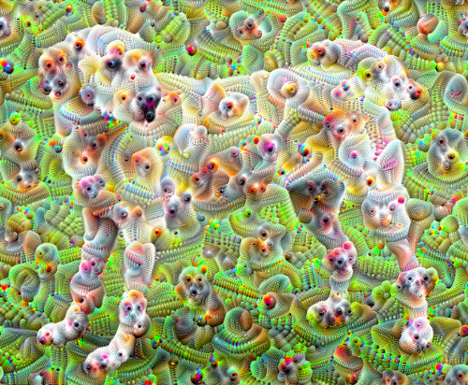
Example of DeepDream Algorithm

Slide 7


Slide 8
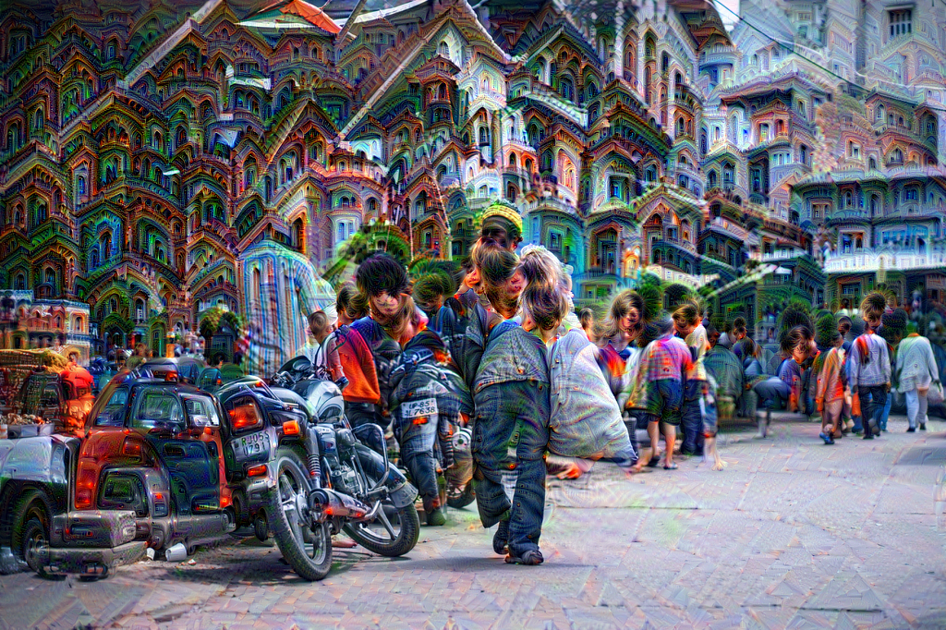

Slide 9
Thank You …!

